Slide 1

PRESENTATION ON IOT BASED SMART GATE
Made by
Sparsh Agrawal (181500722)
Submitted to
Mr. Amir Khan(Technical Trainer)
Department of computer Engineering and technology
GLA UNIVERSITY MATHURA INSTITUTE OF ENGINEERING AND TECHNOLOGY

Slide 2
Index
Introduction
Objective
Layout
Components
Future scope
Conclusion

Slide 3
Introduction
At the time of covid-19 as we all know that how this affect our life styles we carry sanitizers everywhere because of the fear of corona instead of this many people are kept by corona. Because mainly we touched gates at banks,homes,shops,etc.
At those places we want gate keeper for safety they also become patient corona.
For gate keepers this gate is useful to protect them from corona. In this we use ultrasonic sensor and mlx90614 using arduino and we use many modules but these are main sensors.

Slide 4
Objective
The main objective of this project is to protect someone from corona virus or any the virus
Less laboured

Slide 5
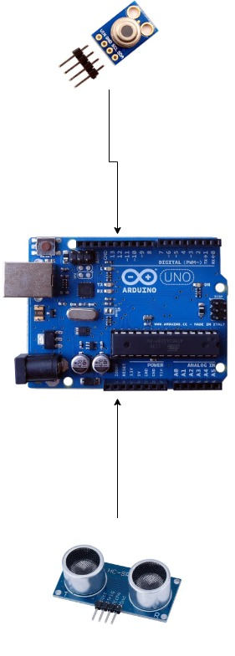
Layout

Slide 6
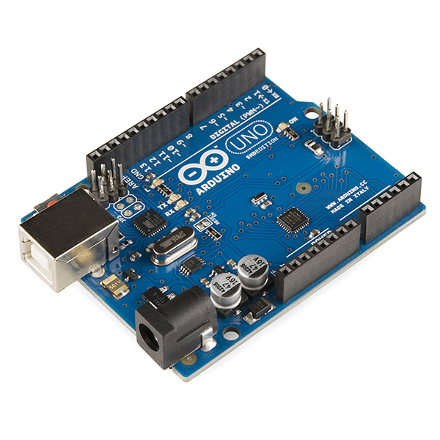
Components
Arduino UNO
The Arduino UNO is an open-source micro controller board based on the Microchip ATmega328P micro controller.

Slide 7
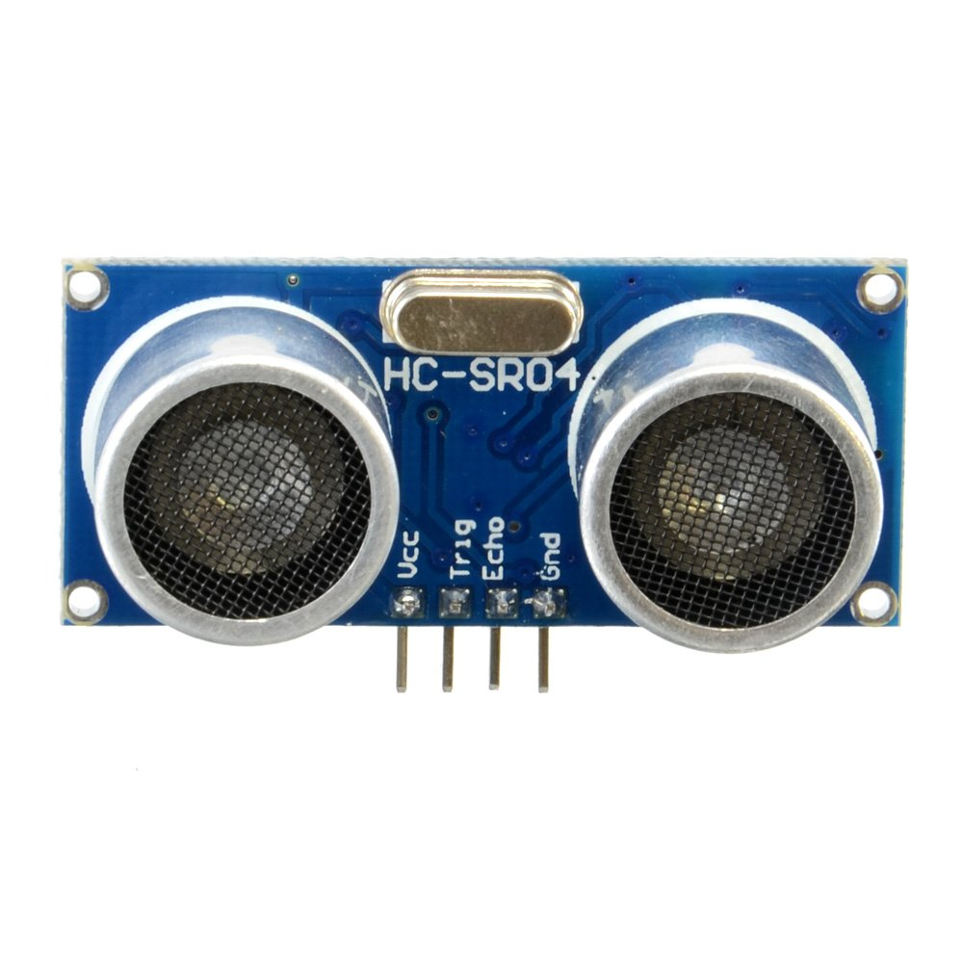
Components
Ultrasonic sensor
Ultrasonic Sensors measure the distance to the target by measuring the time between the emission and reception.

Slide 8
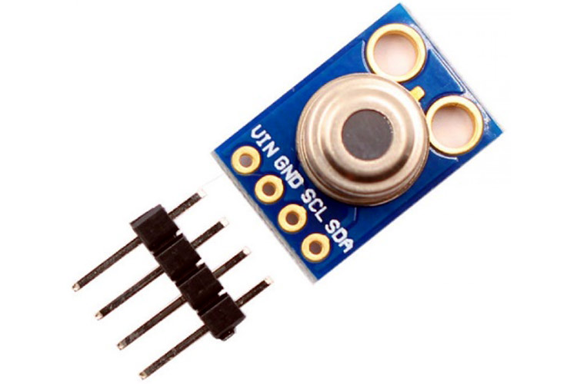
Components
Mlx90614
MLX90614 Contact less Infrared Temperature sensor .The MLX90614 is an infrared thermometer for non-contact temperature measurements capable of measuring temperature.

Slide 9
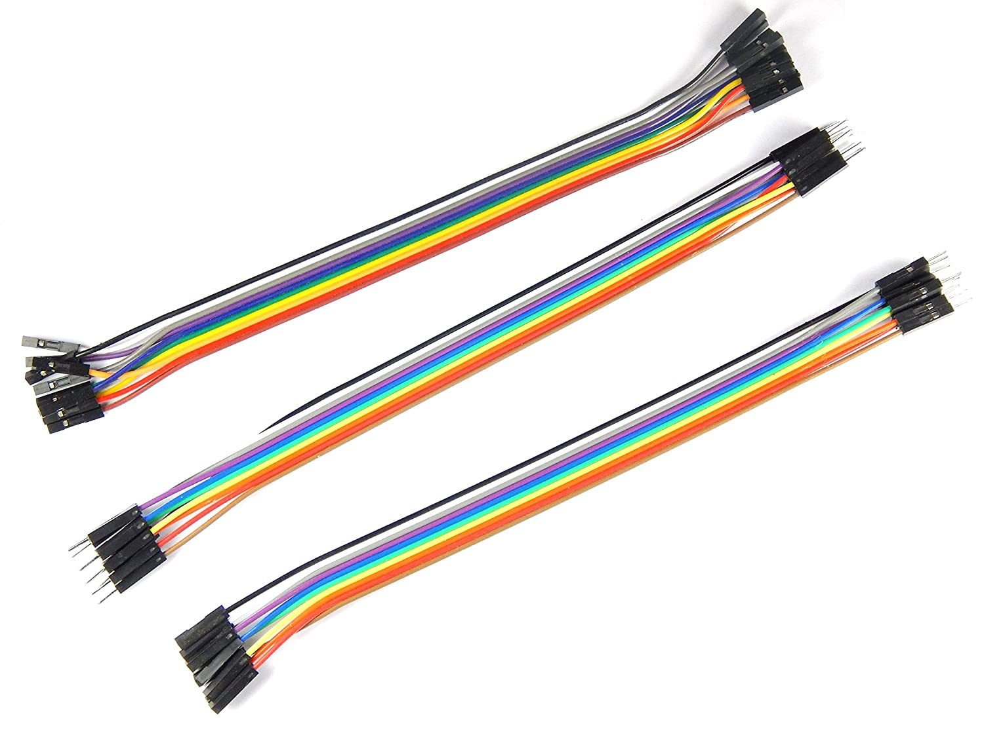
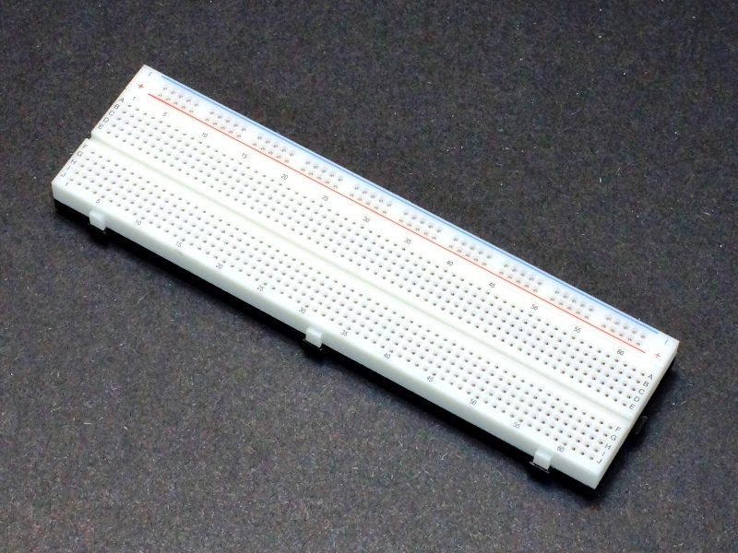
Components
Breadboard jumper wires

Slide 10
Future scope
We can use this gate in smart gate or smart home automation by using some more sensors
We can send health info which generated by this gate to our doctor.
We can make this gate a security gate.
This gate can share the info about home to the owner of the house.

Slide 11
Conclusion
This is just a overview of project. We have may things to research for that type of gate.

Slide 12
Thank you

